Slide 1
Stock market simulator
Kakara Shawn Bhushan(Team Leader)25A3105AI
Matte Durga Prasad-25A31A05AN
Lanke Udaya Lakshmi-25A31A0581
Malladi Tejaswini-25A31A0582

Slide 2
Introduction
Based on Random Walk Theory
Implemented using C++
Simulates stock price movements
Models stock market behavior
Uses random numbers to change price
Helps understand volatility

Slide 3
Main Operations
Input stock price
Generate random numbers
Calculate new price
Store and display prices

Slide 4
Algorithm
Start
Input: Initial Price (P), Steps (N), Volatility (V)
Initialize current price = P and store in list
Generate random changes between −V and +V
Repeat for N steps:
Generate random change (Δ)
Update price: Current Price = Current Price + Δ
If price < 0, set price = 0
Store updated price
Display results:
Simulated stock prices
Final, Maximum, and Minimum price
Stop

Slide 5
System architecture
User Input
↓
Input Module
↓
Processing Module (Functions + Switch Case)
↓
Error Handling (if any)
↓
Output Module
↓
Repeat / Exit

Slide 6
Code
// Input
read initialPrice, steps, volatility
// Initialize
currentPrice = initialPrice
minPrice = initialPrice
maxPrice = initialPrice
print currentPrice // Initial price output
// Simulation & Calculation
for each step from 1 to steps:
change = random value between [-volatility, +volatility]
currentPrice = max(0, currentPrice + change) // Inline floor at 0
// Update bounds
if currentPrice < minPrice: minPrice = currentPrice
if currentPrice > maxPrice: maxPrice = currentPrice
print currentPrice
// Print Summary
print "Final:", currentPrice
print "Max:", maxPrice
print "Min:", minPrice

Slide 7
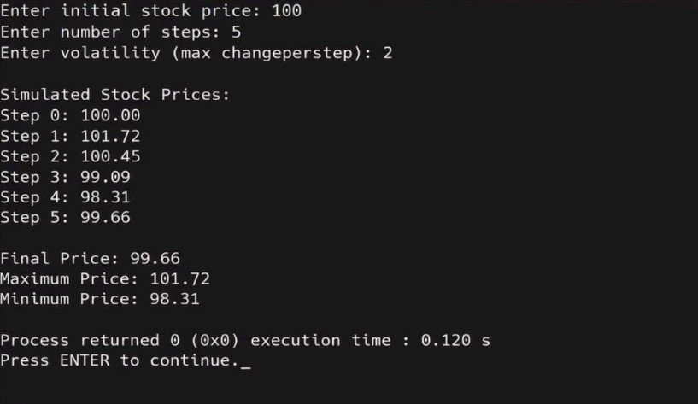
Output

Slide 8
Advantages
Simple simulation model
Demonstrates randomness
Useful for learning
Flexible parameters

Slide 9
Conclusion
Price changes step by step
Shows market fluctuations
Demonstrates C++ simulation project

Slide 10
Thank you

